Slide 1
Lecture-4 (Final) Control Logic Design

Slide 2
Hardware Configuration
Rom bits 13 14 |  | MUX select function
0 | 0 | Increment CAR
0 | 1 | Load input to CAR
1 | 0 | Load input to CAR if S=1, increment CAR if S=0
1 | 1 | Load inputs to CAR if E=1,increment CAR if E=0

Slide 3
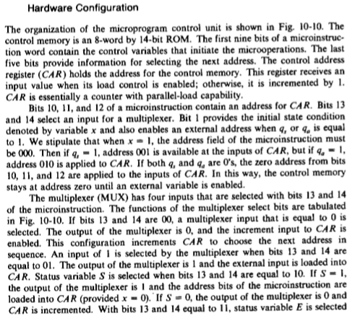

Slide 4


Slide 5
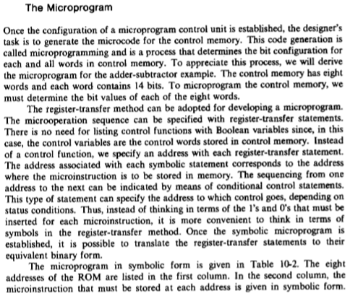

Slide 6
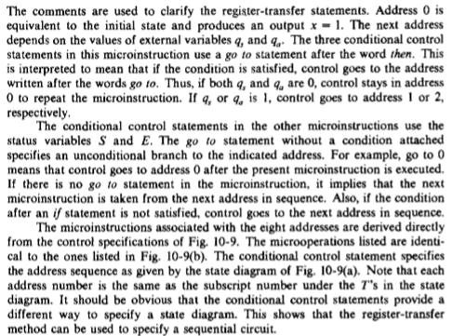

Slide 7
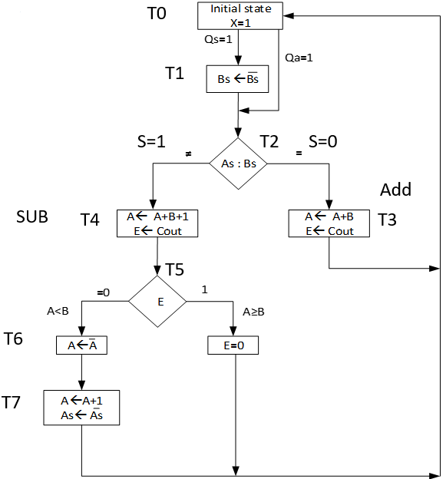
The Microprogram for Control memory

Slide 8
Control of Processor Unit
To construct correct microprograms, it is necessary to specify exactly how the status bits are affected by each microoperation in the processor.
Th S (sign) and Z (Zero) bits are affected by all operations.
The C(Carry) and V (Overflow) bits do not change after the following ALU operations:
The four logic operations OR,AND,XOR, and complement.
The increment and decrement operations.

Slide 9
Flow chart for counting the number of 1’s in register R1
R1 | 1 | 0 | 1 | 0 | C=0 | R2=0
R1 | 0 | 1 | 0 | 1 | C=0 | R2=0
R1 | 0 | 0 | 1 | 0 | C=1 | R2=1
R1 | 0 | 0 | 0 | 1 | C=0 | R2=1
R1 | 0 | 0 | 0 | 0 | C=1 | R2=2

Slide 10
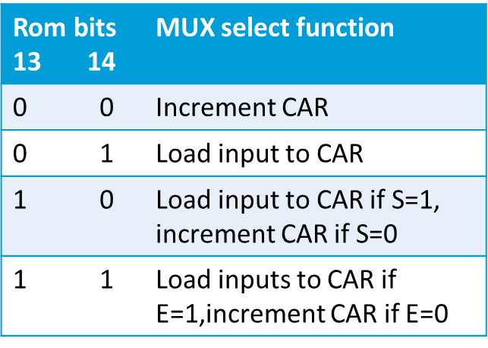
Binary microprogram to count the number of 1’s in R1

